Slide 1
Final Project
By-Yogesh Ghimiray

Slide 2
In Brief:
This is an accounting software where we can record the purchases, sales, returns, receipts and payments. After recording, we can see the reports of the closing inventories, closing account balances, particular account, particular inventory or a particular voucher.
There will be two different types of users; admin and user. The admin user can update the user information of both admin and general users as well as an accountant, but the general user cannot update his/her user information. The request will be sent to the admin via email (SNS) and the admin has to update it. The general user can work as an accountant and post the accounting entries.

Slide 3
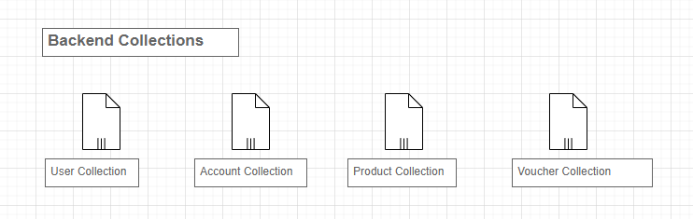

Slide 4
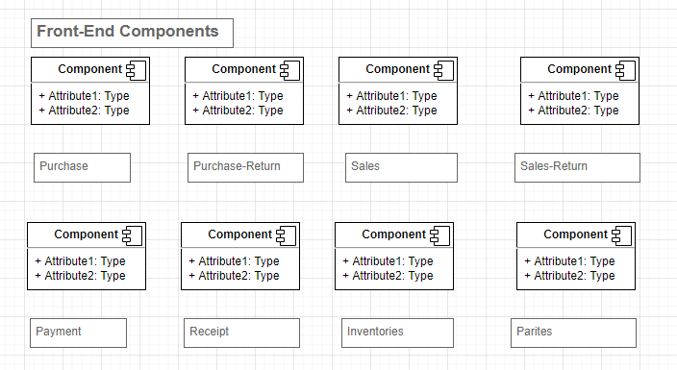

Slide 5
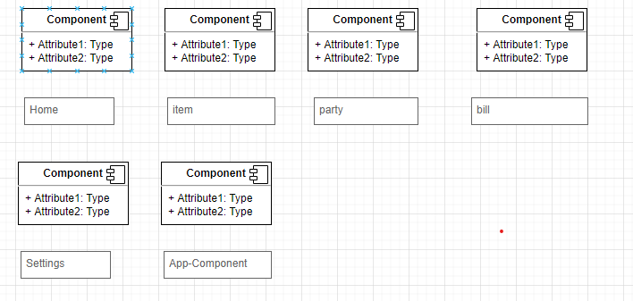
Front-End Components

Slide 6
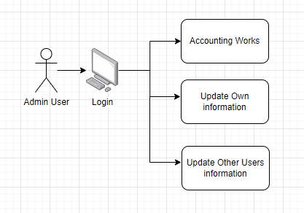
Admin User Login

Slide 7
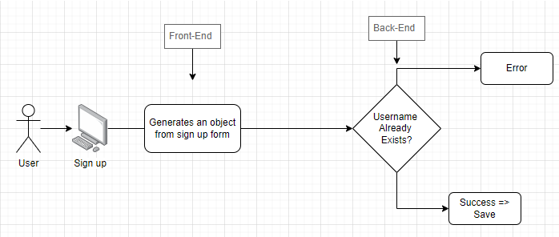
General User Sign up

Slide 8
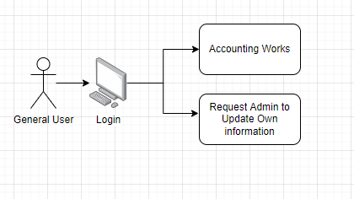
General User Login

Slide 9
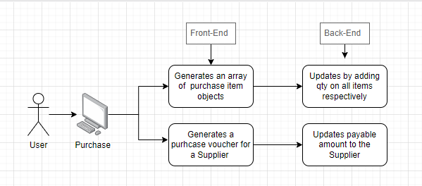
Purchase
In case of purchase return, the opposite transaction takes place.

Slide 10
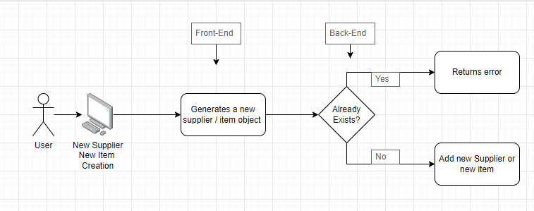
Purchase- Create New Supplier or New Item

Slide 11
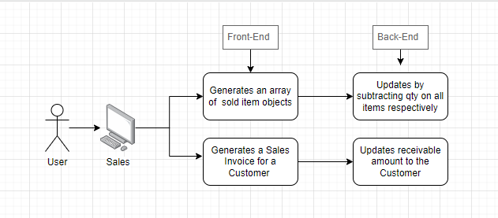
Sales
In case of sales return, the opposite transaction takes place.

Slide 12
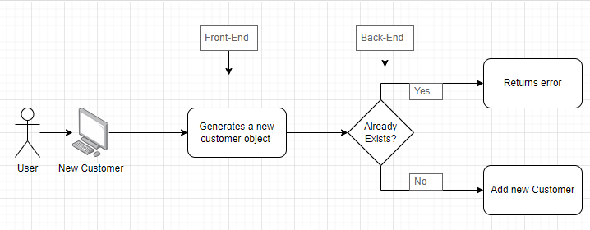
Sales- Create New Customer

Slide 13
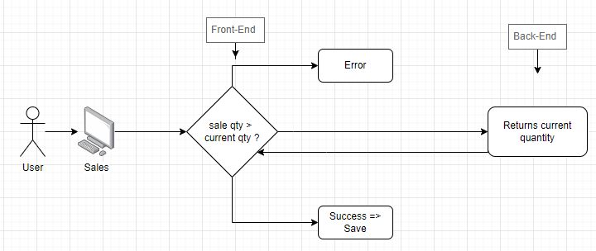
Sales qty. validation
Yes
No

Slide 14
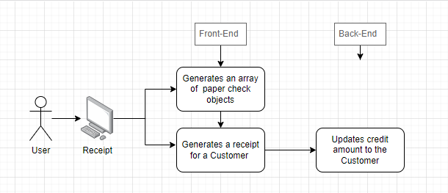
Receipt
In case of payment, the opposite transaction takes place.

Slide 15
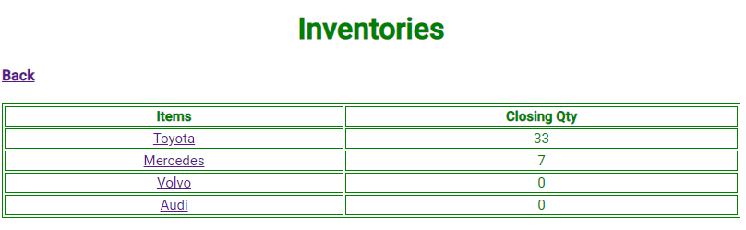
All Inventories
List all items in the product collection of back-end

Slide 16
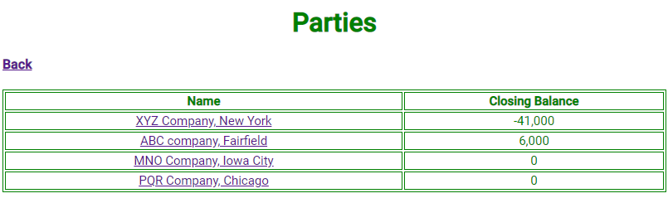
All Parties
List all accounts in the account collection of back-end

Slide 17
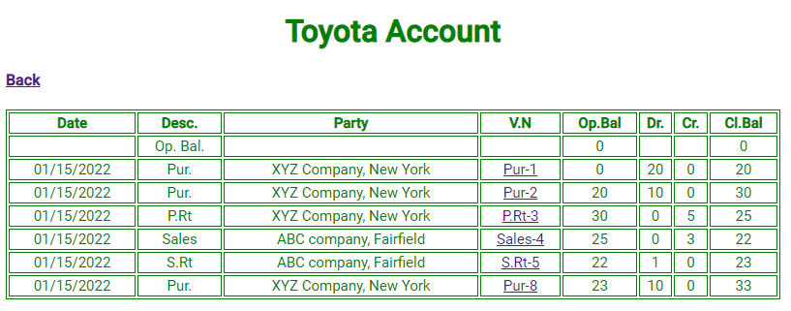
One Inventory Item
Finds the item in product collection of back-end and list all its transactions

Slide 18
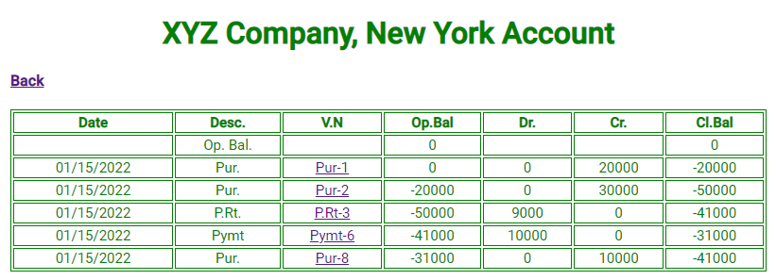
One account
Finds the account in account collection of back-end and list all its transactions

Slide 19
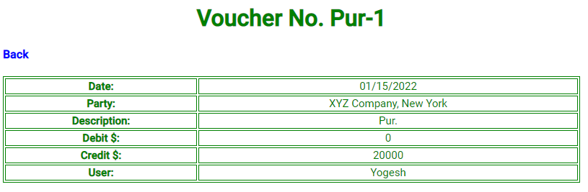
One voucher
Finds the voucher in voucher collection of back-end and list all its details

Slide 20
User Account Settings
Finds the user in user collection of back-end and updates. The front-end checks whether the user is admin or not. If the user is not admin, it checks whether the user is updating own information or someone else.
The back-end again checks whether the logged user is admin or not. If admin, it updates the information, else it sends an email to the admin.

Slide 21
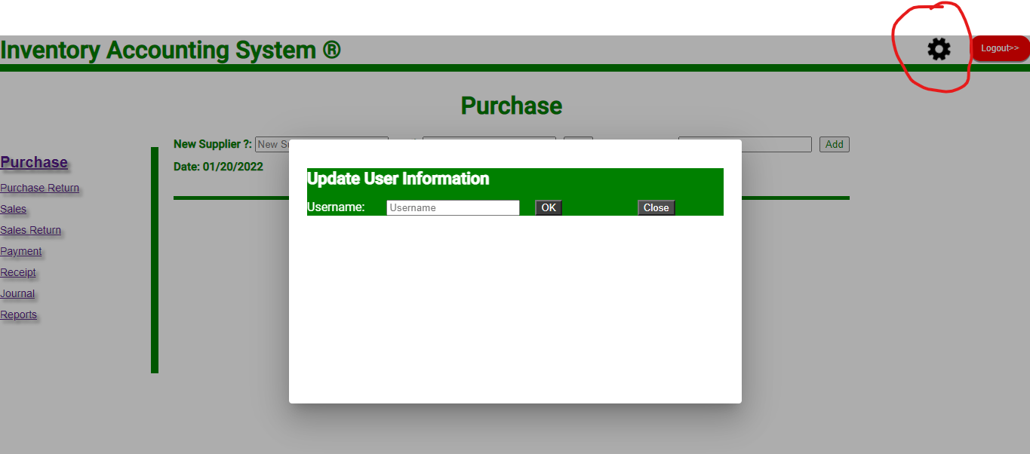
User Account Settings

Slide 22
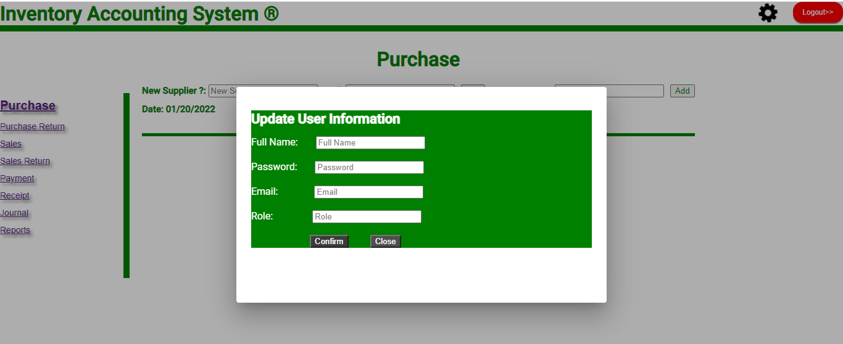
User Account Settings

Slide 23
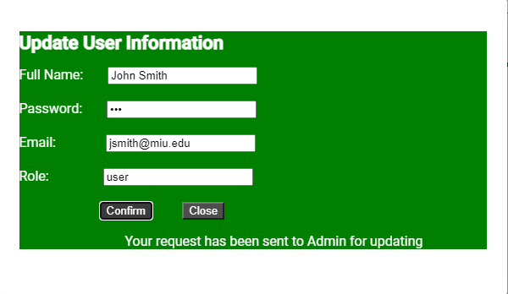
User Account Settings, if not admin user

Slide 24
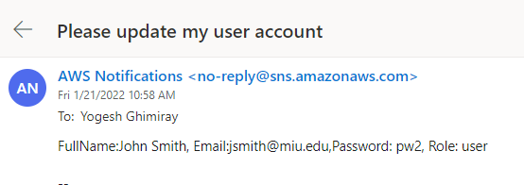
Email to admin to update general user’s account

